Slide 1
Final Project AR
SOLID BREAKER
Aurelio Gamarra, José Antonio Prieto

Slide 2
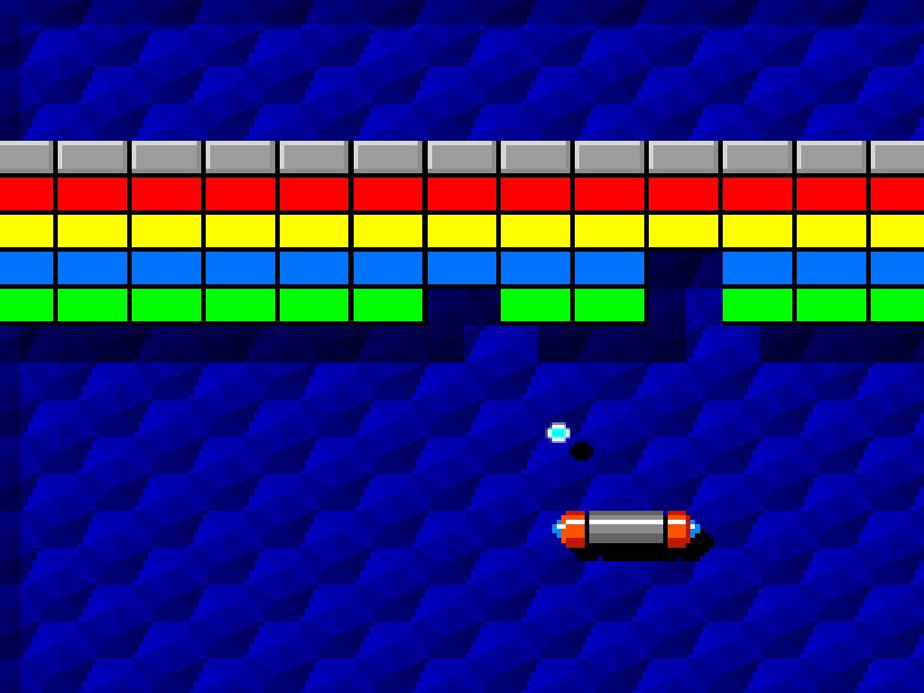
CONCEPT IDEA
Arkanoid type game:
Two player
Each player controls its platform from real world with one QR template
Game mechanics:
Each block color has different behaviour (more though, or more bounce factor, etc)
Only 3 balls for each game, if you lose 3 balls, you lose the game
Win the first player that clears the screen.

Slide 3
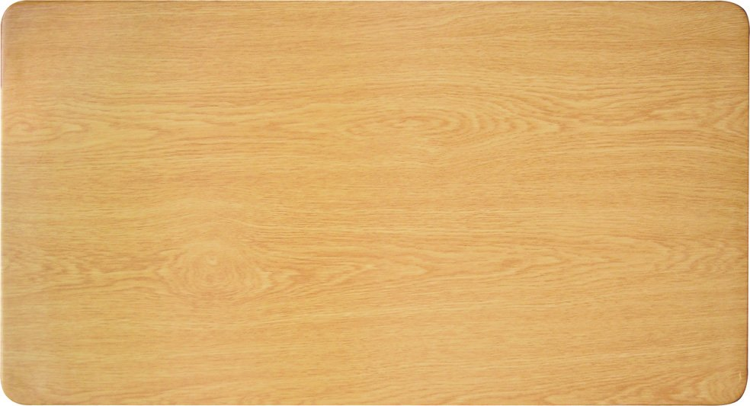

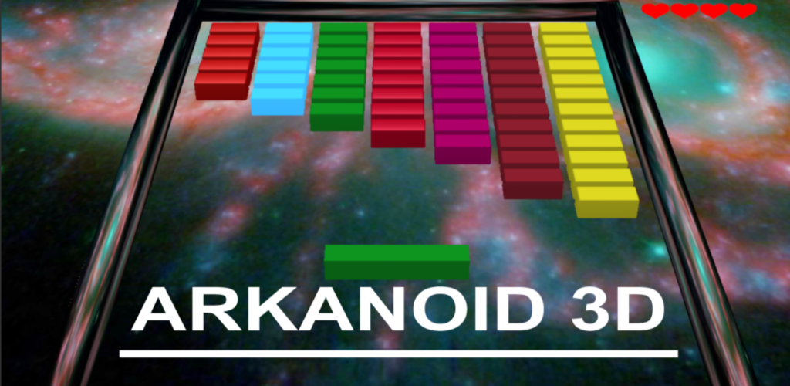
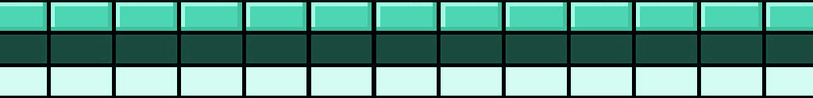

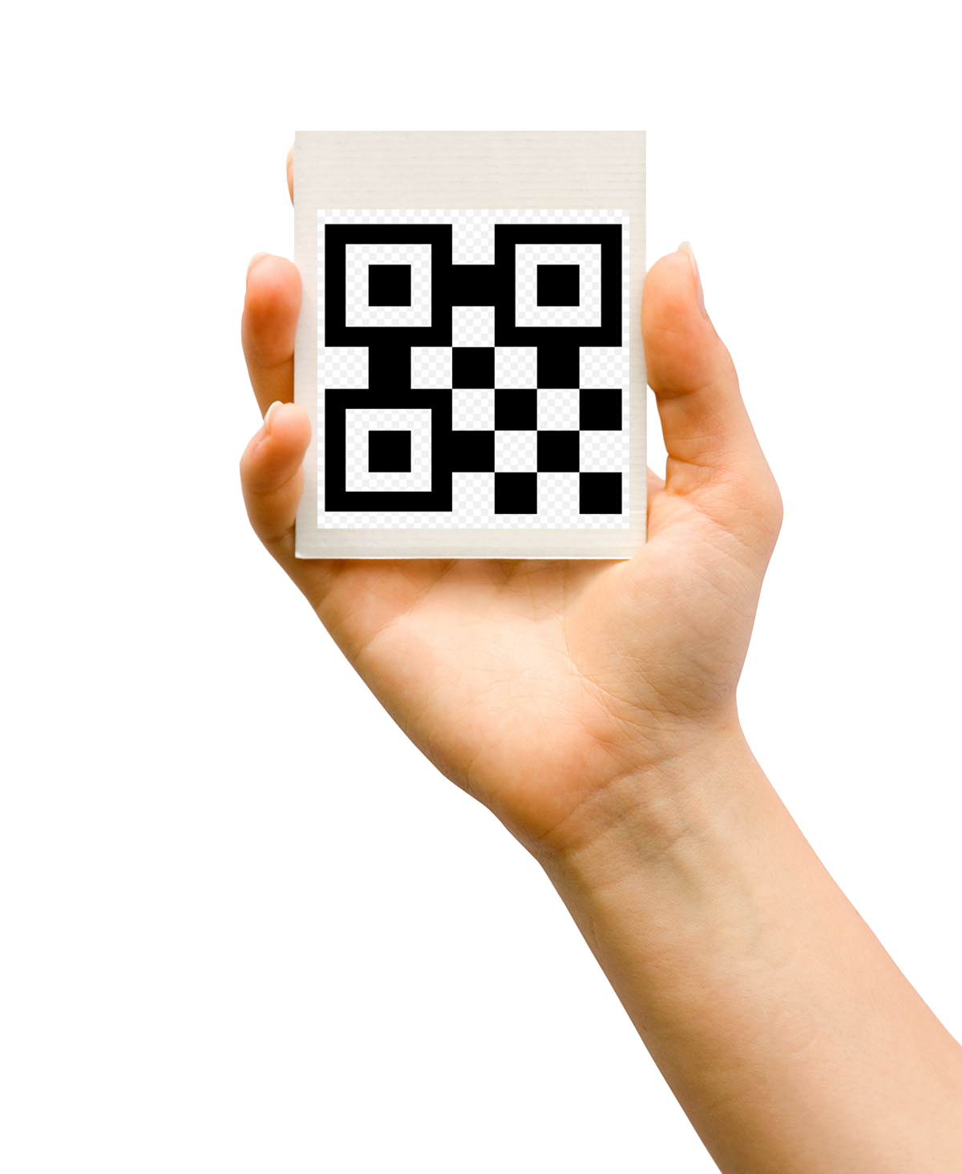
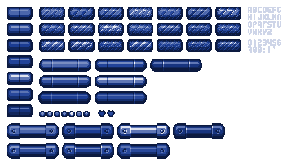
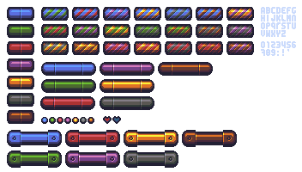

Slide 4

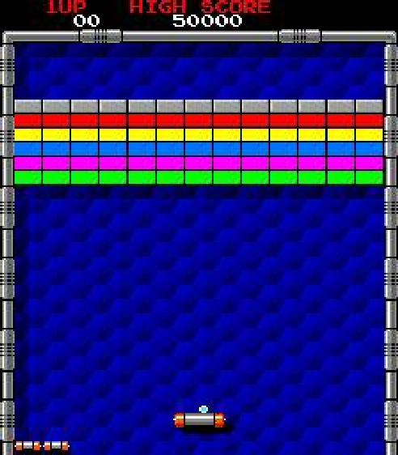
FINAL IDEA
+

Slide 5
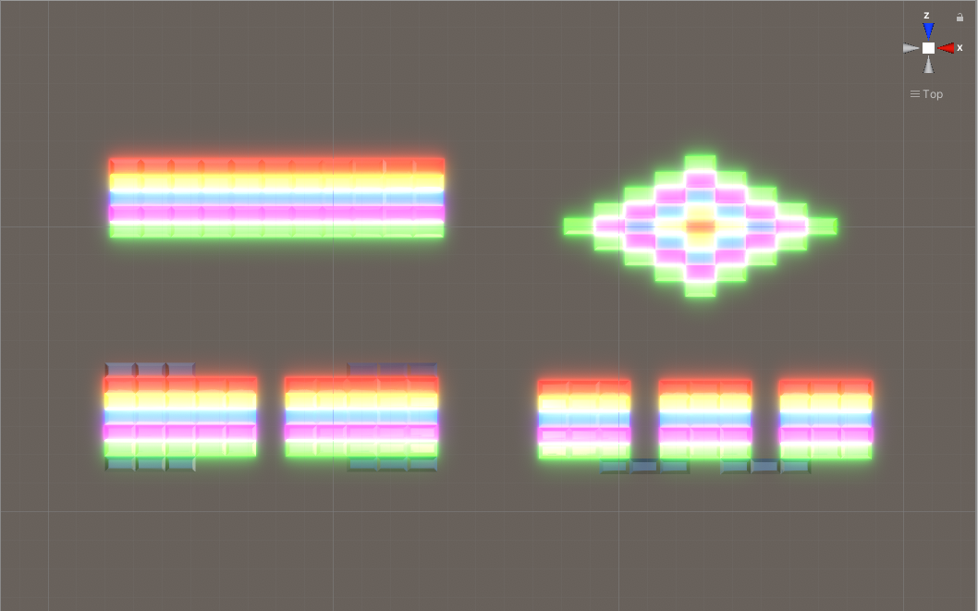
FINAL IDEA
Android platform
Single player
One target to place the board and other for hud
Game mechanics:
Each block color has different score
Only 5 balls for each game, if you lose all balls, you lose the game
4 different levels
5 different power up types (Laser, Enlarge, Disruption, Slow and Extra life)

Slide 6
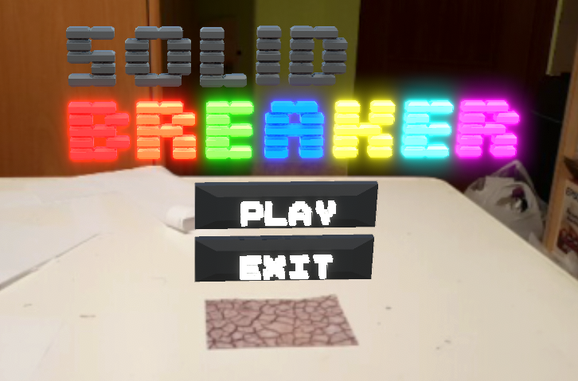
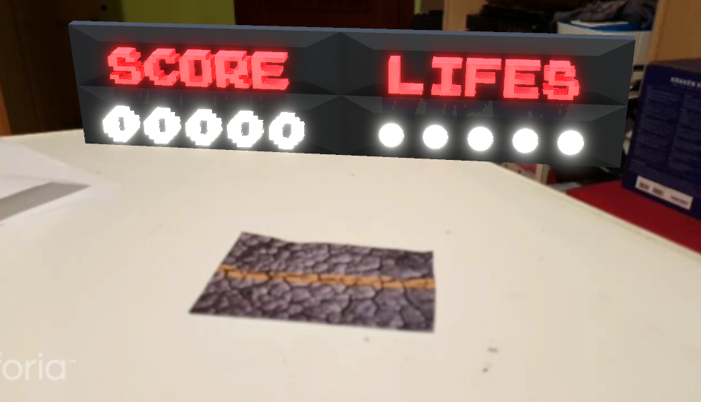
TARGETS

Slide 7
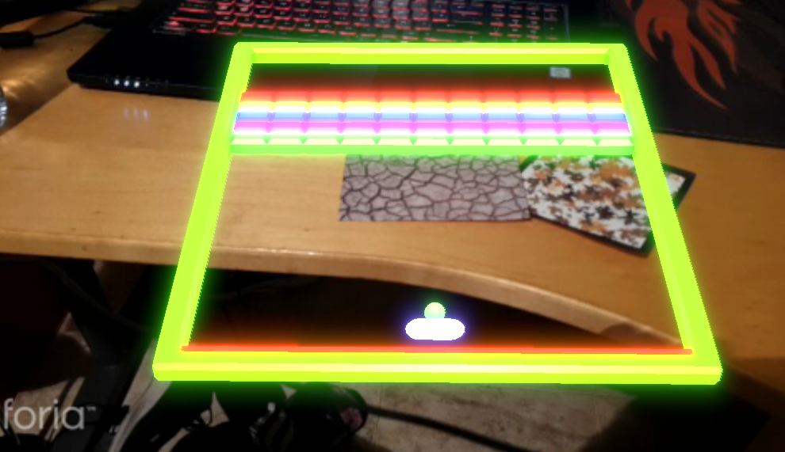
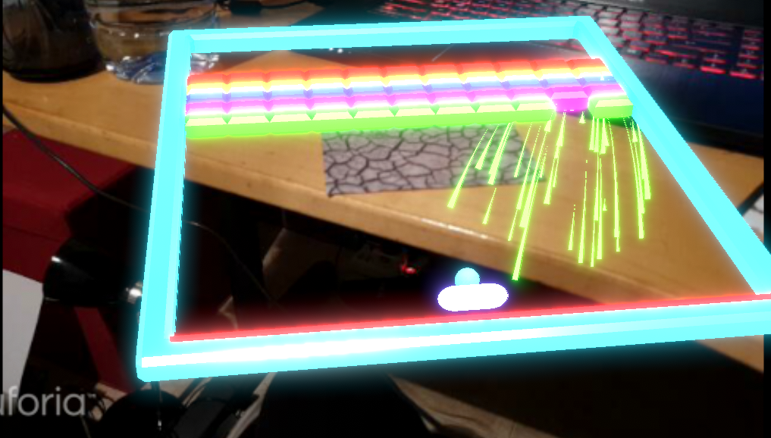
TARGETS

Slide 8
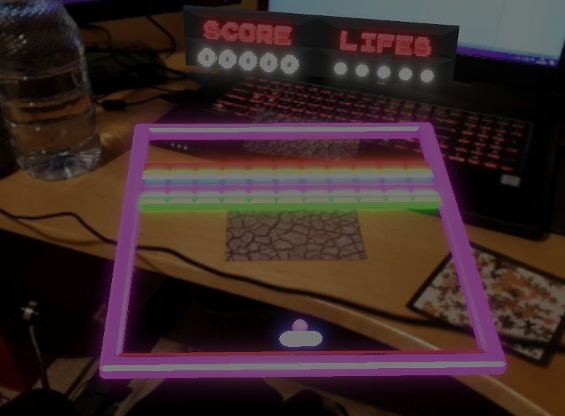
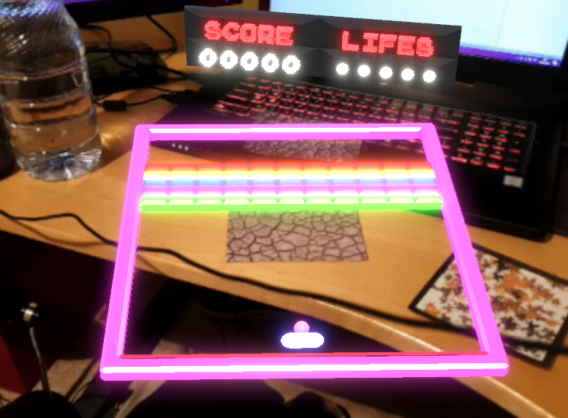
TARGETS

Slide 9
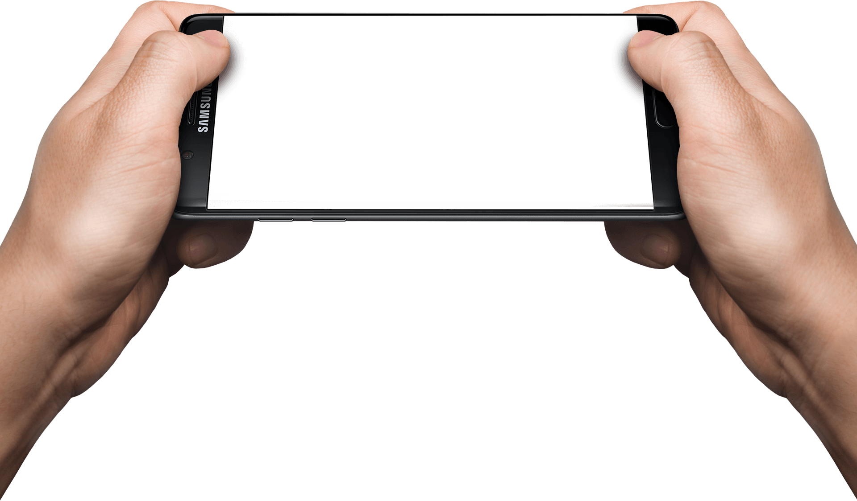
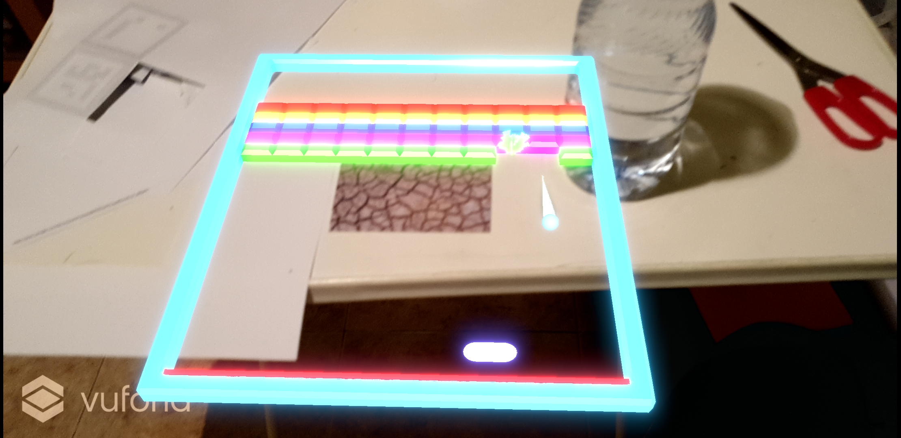
CONTROLS

Slide 10
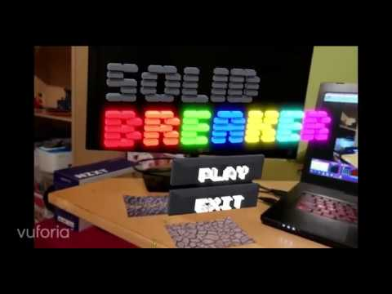
VIDEO GAMEPLAY DEMO

Slide 11
THANK YOU FOR PAY ATTENTION

